Slide 1

Go, change the world
RV College of
Engineering
VI Semester Minor Project Work (18CS64)
Department of Computer Science,
R V College of Engineering, Bengaluru.

Slide 2

Go, change the world
RV College of
Engineering
Project title:
Human Action Recognition in sports
Team members:
Navnith Bharadwaj -1RV19CS098
Kumar Prakhar -1RV19CS078
Mohamed Moin Irfan -1RV19CS089
Internal Guide:
Dr. Praveena T & Assistant Professor

Slide 3
Identification of Problem and Analysis
RV College of
Engineering
Go, change the world
In today’s world, sports has become an important part of society, culture and gaming.
Many systems have been developed to help athletes improve their performance and have better engagement with the audience.
Particularly, sports players and coaches often use action scenes to improve their skill and performance. However, they have to manually analyze action scenes which is expensive and time consuming. This makes Human Action Recognition (HAR) a very important area in sports as it makes the above process automatic and inexpensive.
The task of HAR, which is the focus of this project, is to recognize which human actions are in a particular video sequence, at what time they occur, and where they are located.

Slide 4
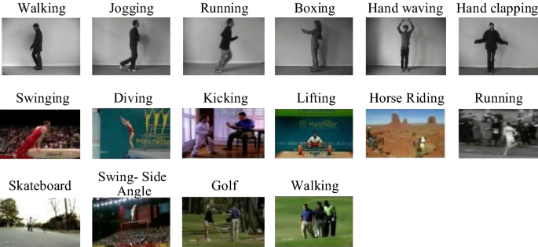
Identification of Problem and Analysis
RV College of
Engineering
Go, change the world
EXAMPLE

Slide 5
Feasibility of Project
RV College of
Engineering
Go, change the world
Due to the diversity of sports movements, noisy scenes, changeable camera motion angle, and other characteristics, it is more difficult to recognize movements.
Skeleton motion sequence is favored by the researchers of motion recognition because of its concise expression of motion mode and insensitivity to light and background.
Present systems use 2-D CNN, Transfer learning, RNN and certain machine learning classification techniques.

Slide 6
Formulation of Objectives
RV College of
Engineering
Go, change the world
To collect and pre processes data.
Split each video into frames and do feature extraction.
Split the data set into a training and testing set.
Use Openpose for feature extraction which gives 17 key points.
After preprocessing data, convert it into an tuple and pass it to RNN.
Perform Training using LSTM-RNN on the output of the Openpose model.
Then analyze the results of the above model using a testing set and evaluate its performance.

Slide 7
Methodology
RV College of
Engineering
Go, change the world
Split each video into frames and do feature extraction.
Split the data set into training and testing set.
Openpose for feature extraction which gives 17 key points using Openpose.
After preprocessing data convert it into array and pass it to RNN.
Perform Training using LSTM-RNN on the output of the CNN model.
Classify the output of the above models to recognise the action.
Then analyse the results of the above model using testing set and evaluate its performance.

Slide 8
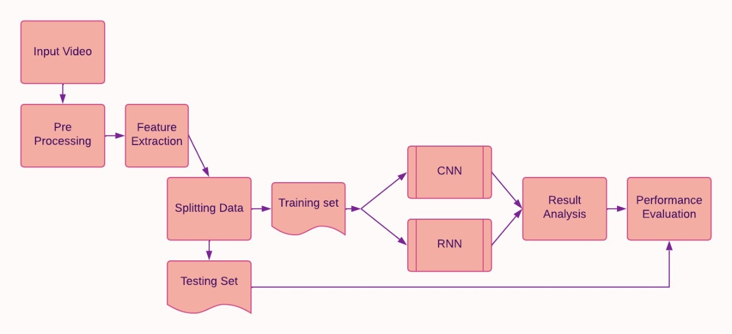
Methodology
RV College of
Engineering
Go, change the world

Slide 9
Go, change the world
Go, change the world
Literature Survey
RV College of
Engineering
Literature Survey
RV College of
Engineering
Year, Name of the Journal, Conference | Title of The Paper | Authors of the Paper | Description of the Paper | Limitations of the Paper/ Future Work
2022,Computational Intelligence and Neuroscience |  | Rahim Khan | model based on deep learning (DL) and clustering extraction algorithm The neural network (NN) is applied to the sample set containing images of nonathletes, and the negative training sample set is iteratively enhanced according to the generated false positives, and the results are optimized by clustering method. | The non-DL method relies too much on artificial prior knowledge, which requires higher sports action video library.
2021,The 16th International Conference on Computer Science & Education | A New Action Recognition Framework for Video Highlights Summarization in Sporting Events | Cheng Yan; Xin Li; Guoqiang Li | We propose to utilize the three-level prediction model based on two open-source structures to automatically recognize players’ action, and then efficiently summarize the sports highlights. We recognize player actions using both YOLO v3 and OpenPose, respectively, and compare their performance. | Training is slow Cannot distinguish between match relevant and match irrelevant players Errors occur when too many people in the video
IEEE Sensors Journal ( Volume: 20, Issue: 11, June1, 1 2020) | Simultaneous Utilization of Inertial and Video Sensing for Action Detection and Recognition in Continuous Action Streams | Haoran Wei; Nasser Kehtarnavaz | The inertial and video data are captured simultaneously via a wearable inertial sensor and a video camera, which are turned into 2D and 3D images These images are then fed into a 2D and a 3D CNN with their decisions fused in order to detect and recognize a specified set of actions of interest from continuous action streams | Wearable inertial sensors need to be worn on the body.
Year, Name of the Journal, Conference | Title of The Paper | Authors of the Paper | Description of the Paper | Limitations of the Paper/ Future Work
2022,Computational Intelligence and Neuroscience | Analysing the Trend of Stock Market and Evaluate the performance of Market Prediction using Machine Learning Approach |  | model based on deep learning (DL) and clustering extraction algorithm The neural network (NN) is applied to the sample set containing images of nonathletes, and the negative training sample set is iteratively enhanced according to the generated false positives, and the results are optimized by clustering method. | The non-DL method relies too much on artificial prior knowledge, which requires higher sports action video library.
2021,The 16th International Conference on Computer Science & Education | A New Action Recognition Framework for Video Highlights Summarization in Sporting Events | Cheng Yan; Xin Li; Guoqiang Li | We propose to utilize the three-level prediction model based on two open-source structures to automatically recognize players’ action, and then efficiently summarize the sports highlights. We recognize player actions using both YOLO v3 and OpenPose, respectively, and compare their performance. | Training is slow Cannot distinguish between match relevant and match irrelevant players Errors occur when too many people in the video
IEEE Sensors Journal ( Volume: 20, Issue: 11, June1, 1 2020) | Simultaneous Utilization of Inertial and Video Sensing for Action Detection and Recognition in Continuous Action Streams | Haoran Wei; Nasser Kehtarnavaz | The inertial and video data are captured simultaneously via a wearable inertial sensor and a video camera, which are turned into 2D and 3D images These images are then fed into a 2D and a 3D CNN with their decisions fused in order to detect and recognize a specified set of actions of interest from continuous action streams | Wearable inertial sensors need to be worn on the body.
*
9
*
9

Slide 10
Go, change the world
Literature Survey
RV College of
Engineering
Year, Name of the Journal, Conference | Title of The Paper | Authors of the Paper | Description of the Paper | Limitations of the Paper/ Future Work
2018 IEEE International Conference on Big Data (Big Data) | Recognition of Daily and Sports Activities | Nihat İnanç , Murat Kayri , Ömer Faruk Ertuğrul | In this paper, the daily and sports activities dataset was employed in order to recognize action type, action, gender and also to investigate the effect of the position of the sensor node and the sensor type on the overall accuracy. ELM classification is used. | Results showed that the proposed approach can be successfully employed in order to distinguish the action types. But the accuracies in detecting the actions, and gender is low. Also it was found that near similar accuracies were achieved by using the logs of a single sensor, which is ACC in Z-dimension on the right arm. Therefore, it can be noted that the performance of an action recognition system is highly dependent to the sensor type and sensor position.
2021 5th Asian Conference on Artificial Intelligence Technology (ACAIT) | Research on Sports Image Recognition and Tracking Based on Computer Vision Technology | Youlin Song | A hybrid algorithm (S-D) is proposed by combining semi-naive Bayes classification algorithm (SNBC) and dense trajectory algorithm (DT). | SNBC has a high efficiency in image recognition, but it is not accurate enough to recognize the movement of people in sports images. The research combines DT and SNBC, proposes the S-D algorithm, and builds a S-D model based on it. results show that the S-D algorithm can effectively improve the recognition accuracy of sports images and has high practicability. However, the study doesn’t analyze the recognition effect of the S-D algorithm in a complex environment
2020 IEEE International Conference on Multimedia & amp; Expo Workshops (ICMEW) | Efficient fitness action analysis based on spatio-temporal feature encoding | Jianwei Li , Hainan Cui , Tianxiao Guo , Qingrui Hu and Yanfei Shen | This paper proposes a simple yet efficient spatio-temporal skeleton encoding method, and design a novel human action analysis method to recognize and evaluate fitness actions. | this paper focuses on spatio-temporal skeleton encoding. first the Skeleton extraction and simplification is done then Skeleton feature encoding is performed to get the spatio-temporal skeleton image and later action analysis is performed. Further increasing the recognition accuracy of complex dynamic movements is required.
*
10

Slide 11
Go, change the world
Literature Survey
RV College of
Engineering
Year, Name of the Journal, Conference | Title of The Paper | Authors of the Paper | Description of the Paper | Limitations of the Paper/ Future Work
2021 IEEE International Conference on Advances in Electrical Engineering and Computer Applications | Elements and construction of sports visual image action recognition system based on visual attention analysis | Kun Luo | Broad system diagram given Common feature classification table The sports visual image system constructed by various complex sports images contains rich visual content, highlights the charm of sports, and plays an important role in the dissemination and promotion of sports culture | Not implemented only theoretical
2019 International Conference on Electrical, Computer and Communication Engineering | Classification of sports videos with combination of deep learning models and transfer learning | Mohammad Ashraf Russo; Laksono Kurnianggoro; Kang-Hyun Jo | CNN extracted features are combined with temporal information from RNN to formulate the general model to solve the problem Initially, they make a small dataset consisting of only 5 sports classes-Basketball, Cricket, Football, Ice Hockey, Tennis. Each class contains 60 sequences in total and each sequences contains 64 sequential frames. Later dataset is scaled to 10 classes. In the recurrent part, the gated recurrent units (GRU) was used. After CNN and RNN, transfer learning model VGG-16 is used. | When scaling up the dataset for larger classification task, such as 15 classes which has ambiguity in themselves, it becomes quite difficult. there is still much room for improvement, other deep learning based techniques that could be applied for such task are data augmentation, fine tuning to adopt weights more to the specific dataset
*
11

Slide 12
Go, change the world
Literature Survey
RV College of
Engineering
Year, Name of the Journal, Conference | Title of The Paper | Authors of the Paper | Description of the Paper | Limitations of the Paper/ Future Work
2021 IEEE 10th Global Conference on Consumer Electronics (GCCE) | Sports Action Detection Based on Self-Supervised Feature Learning and Object Detection | Tsuyoshi Masuda , Ren Togo , Takahiro Ogawa† and Miki Haseyama‡ | The proposed method realizes action detection without a fine grained annotation based on self-supervised feature learning and object detection. | the self-supervised feature learning works well when a single person is on a video. Thus, we introduce object detection into our method to achieve action detection for multiple persons by tracking each person.
2021 IEEE 8th Uttar Pradesh Section International Conference on Electrical, Electronics and Computer Engineering (UPCON) | Vision based Human Activity Recognition using Deep Transfer Learning and Support Vector Machine | Kamal Kant Verma; Brij Mohan Singh | Feature extraction and representation has been performed using a fine-tuned VGG-19 model. Then, a non-linear multi-class support vector machine is used to classify the extracted features into the activity classes. Dataset: UCF Sports Action dataset | the number of frames in each sports video sequence varies from 62 to 387 for UCF Sports Action dataset therefore, some loss of information exists. The total false positive rate (error) of the proposed approach is 0.291. The main cause of this error is due to the three sports activities namely Running, Skateboarding and Walking. The reason being is that the activities Running, Skate-boarding and Walking in the confusion matrix have higher confusion as compare to the other activities of the dataset.
*
12

Slide 13
Methodology
RV College of
Engineering
Go, change the world
THANK YOU

